Slide 1

beauty salon

Slide 2
Problems
To solve the congestion problem in the beauty salon
Don't waste time waiting Make an appointment to facilitate booking and attend at the same time
لحل مشكلة الازدحام في الصالون عدم تضييع الوقت في الانتظار تحديد موعدًا لتسهيل الحجز والحضور في نفس الوقت

Slide 3
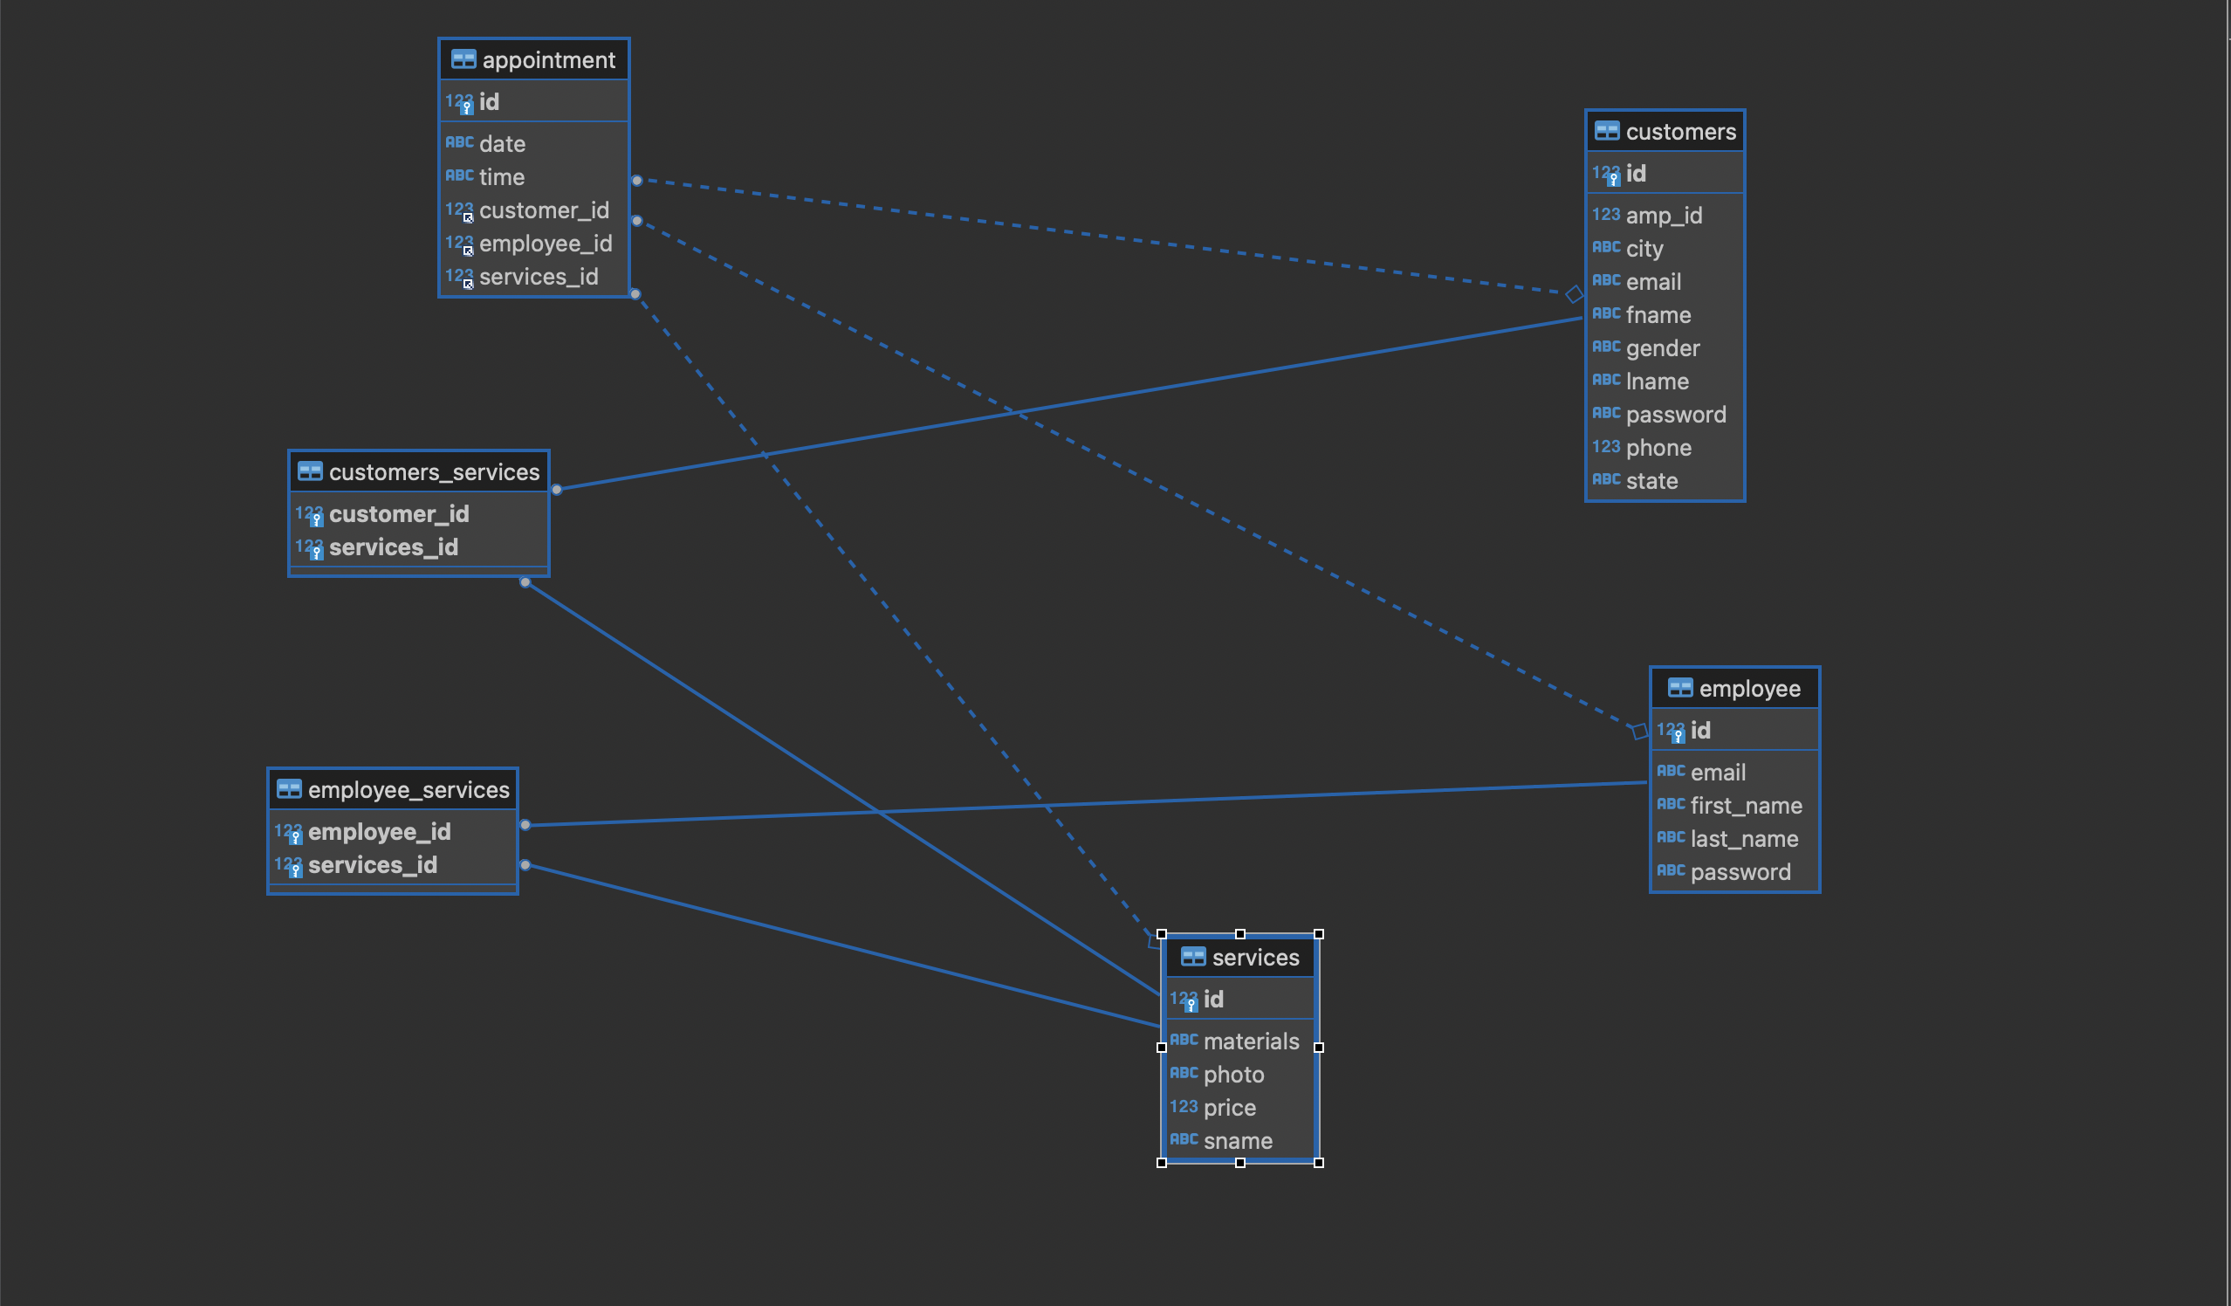
ERD

Slide 4
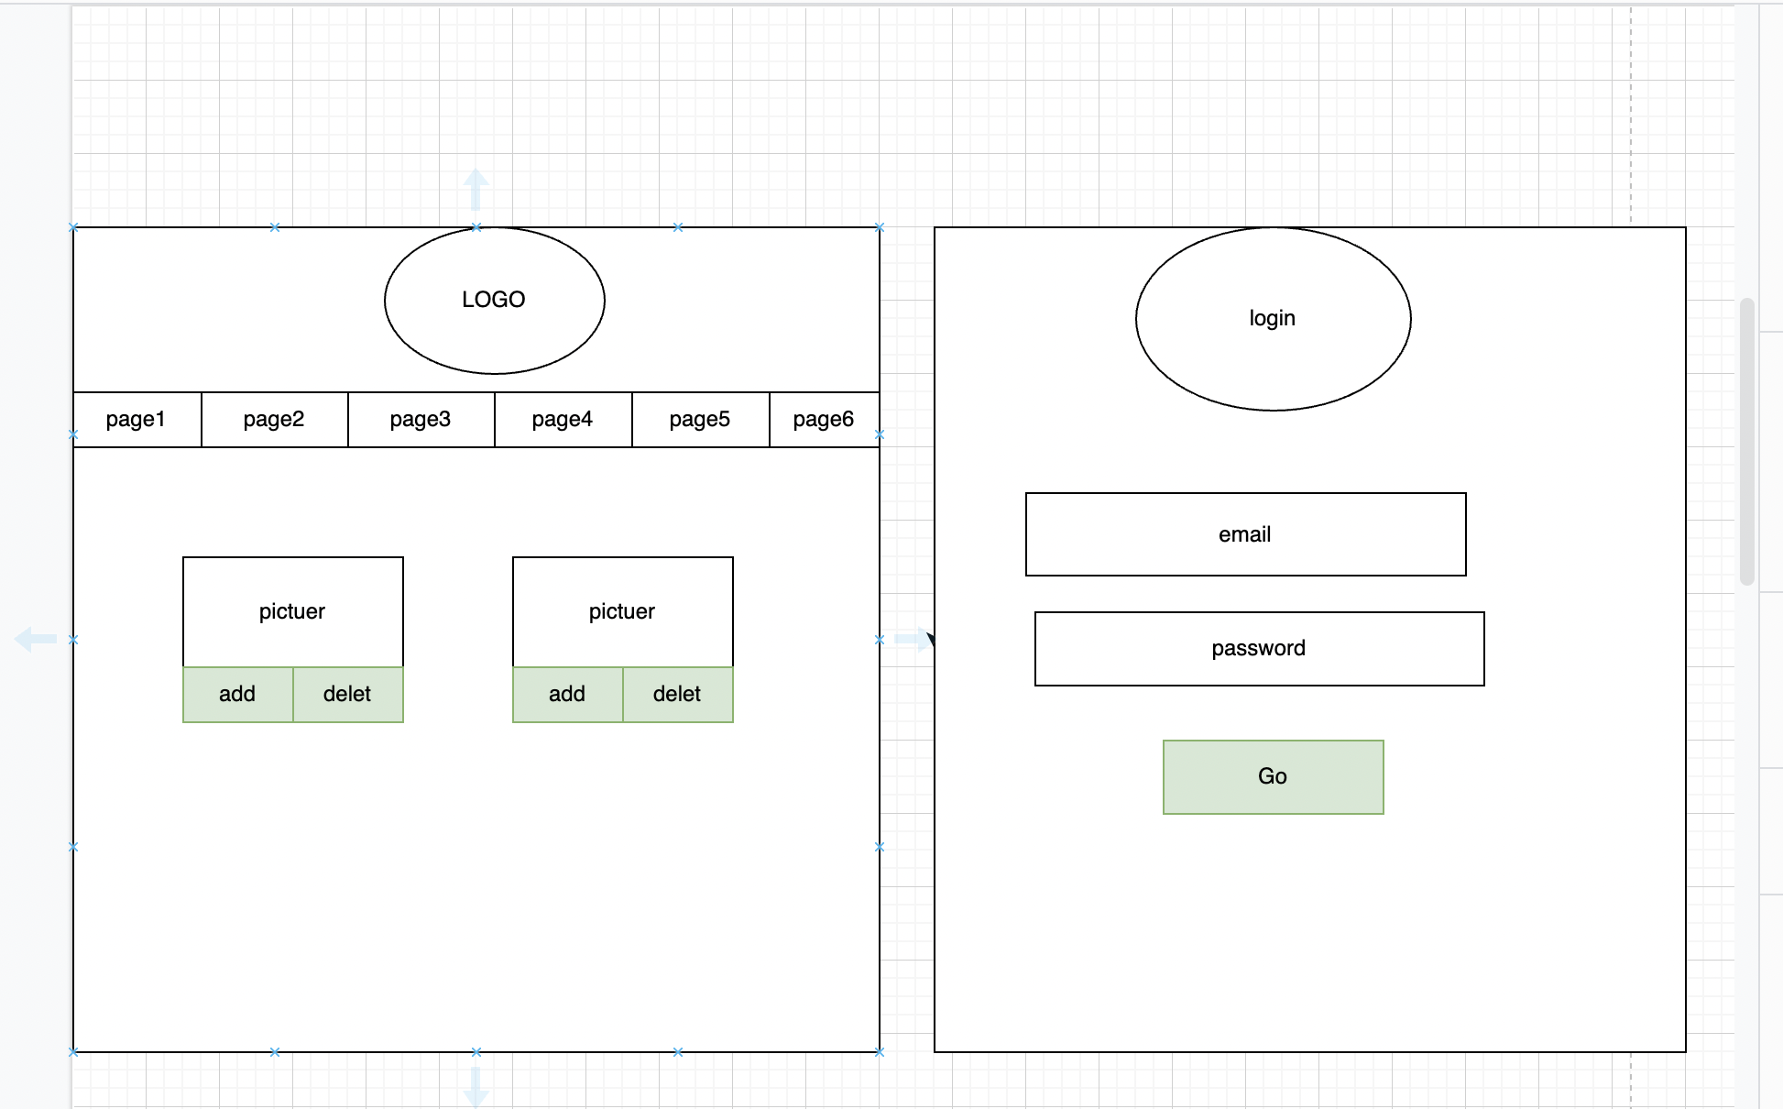
Wireframe

Slide 5
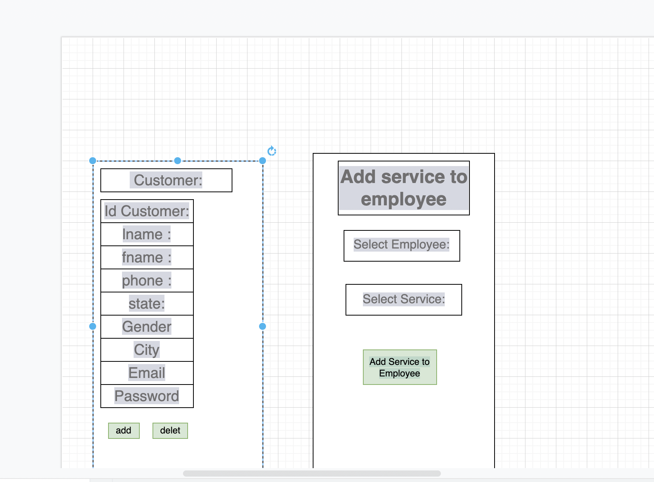
Wireframe

Slide 6
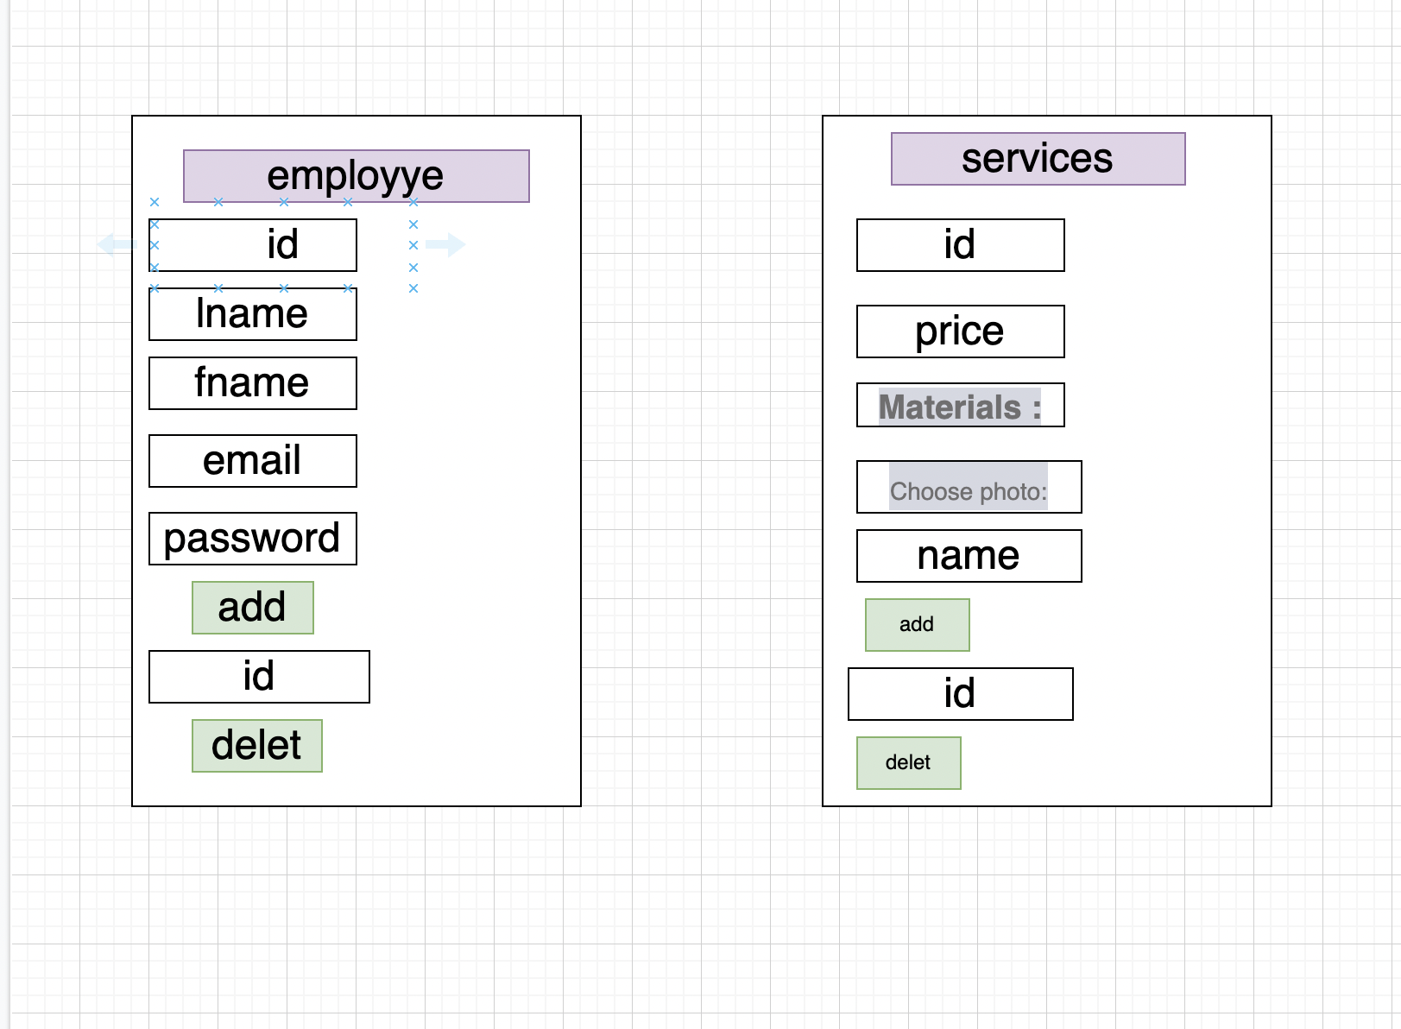
Wireframe

Slide 7
Wireframe

Slide 8
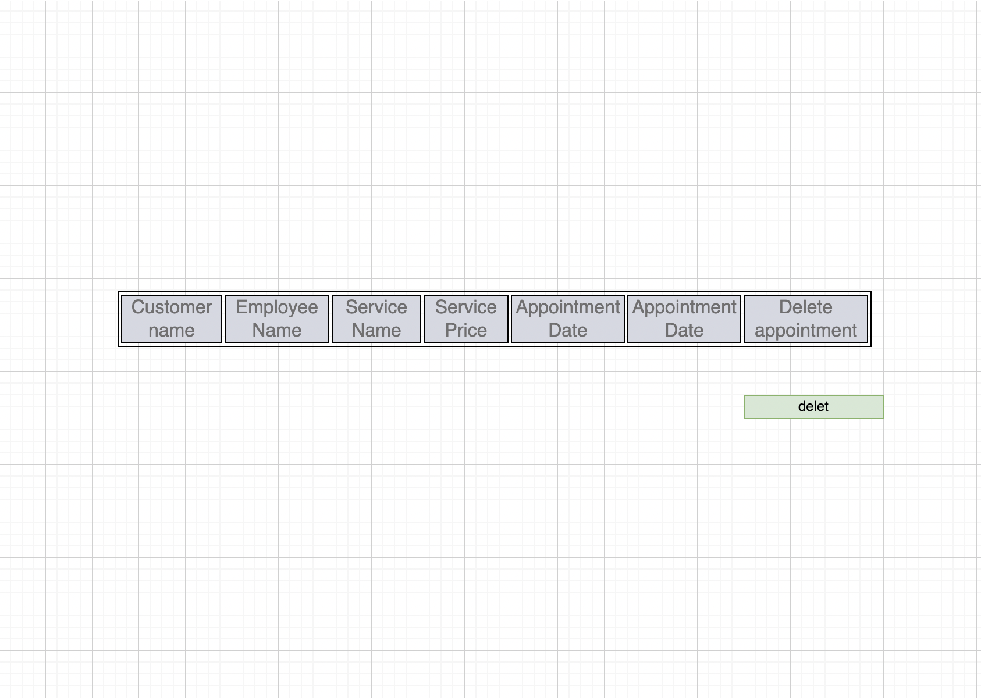
Wireframe

Slide 9
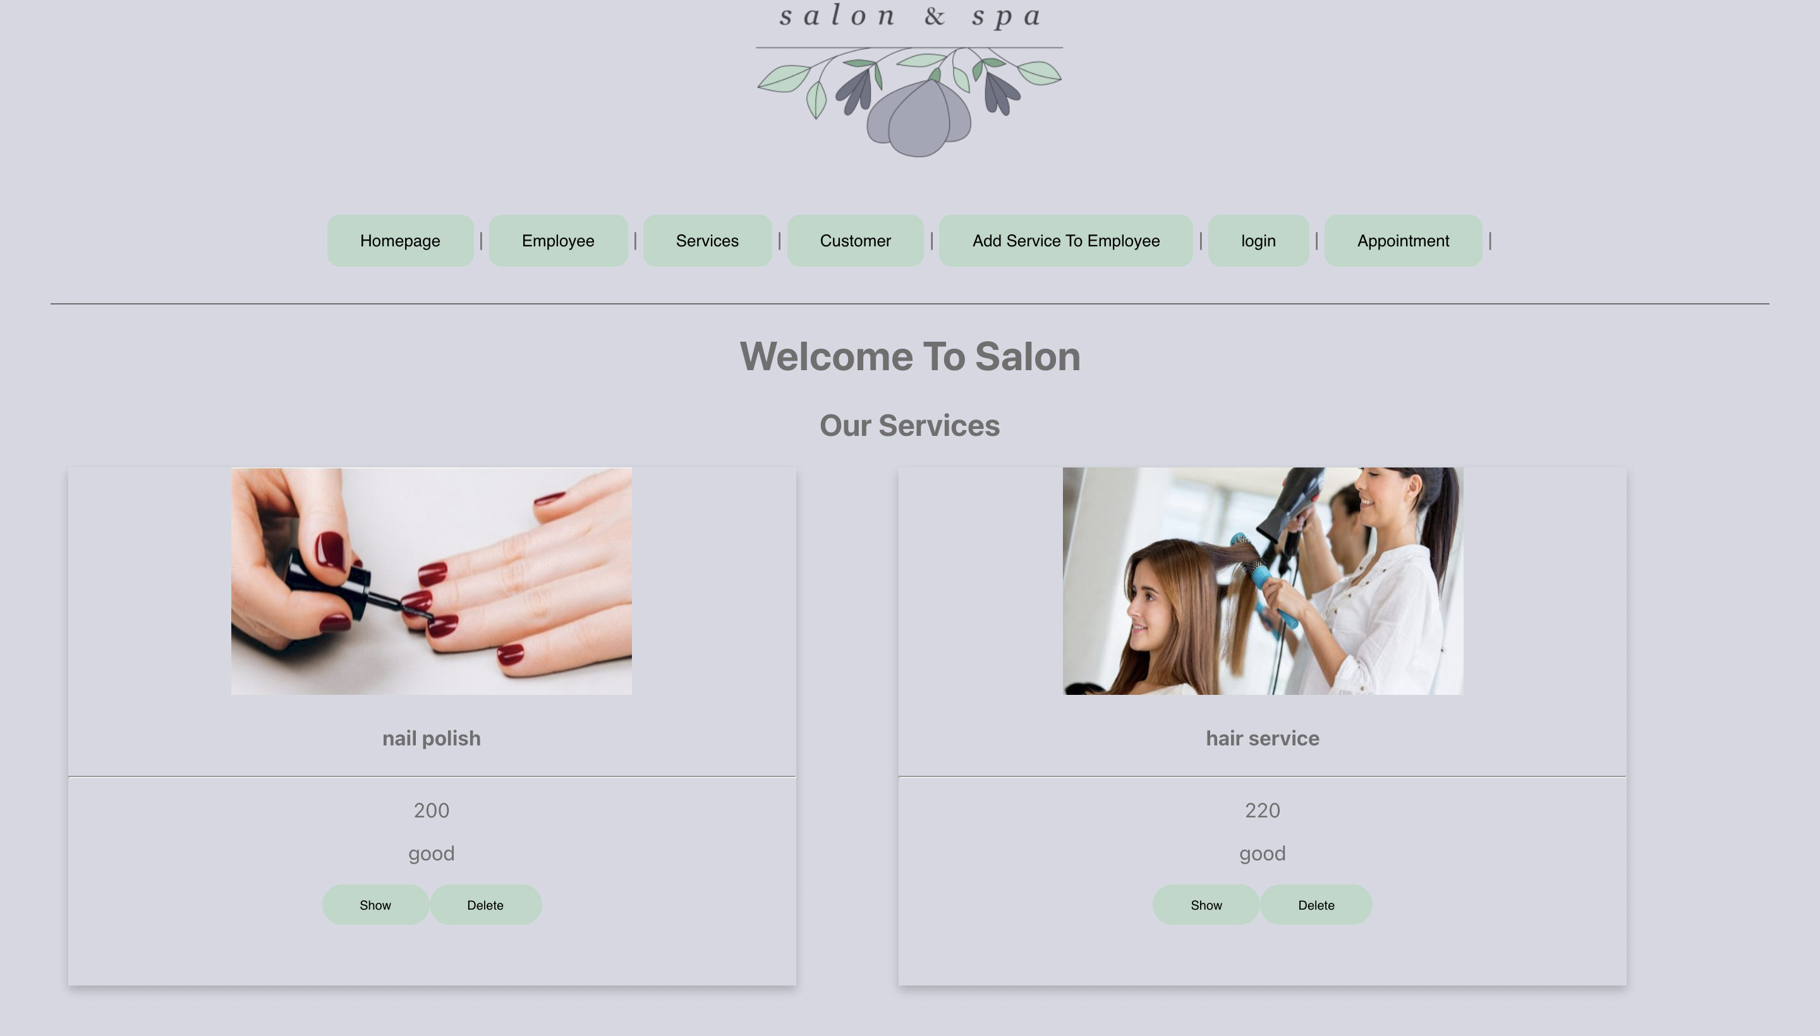
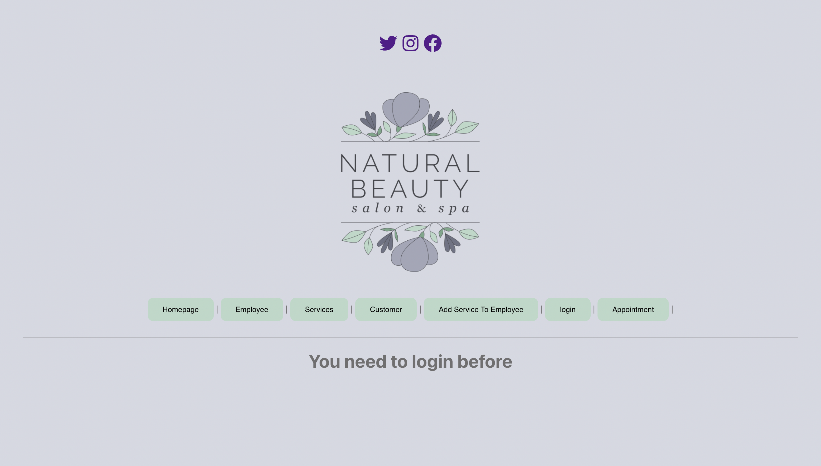

Slide 10
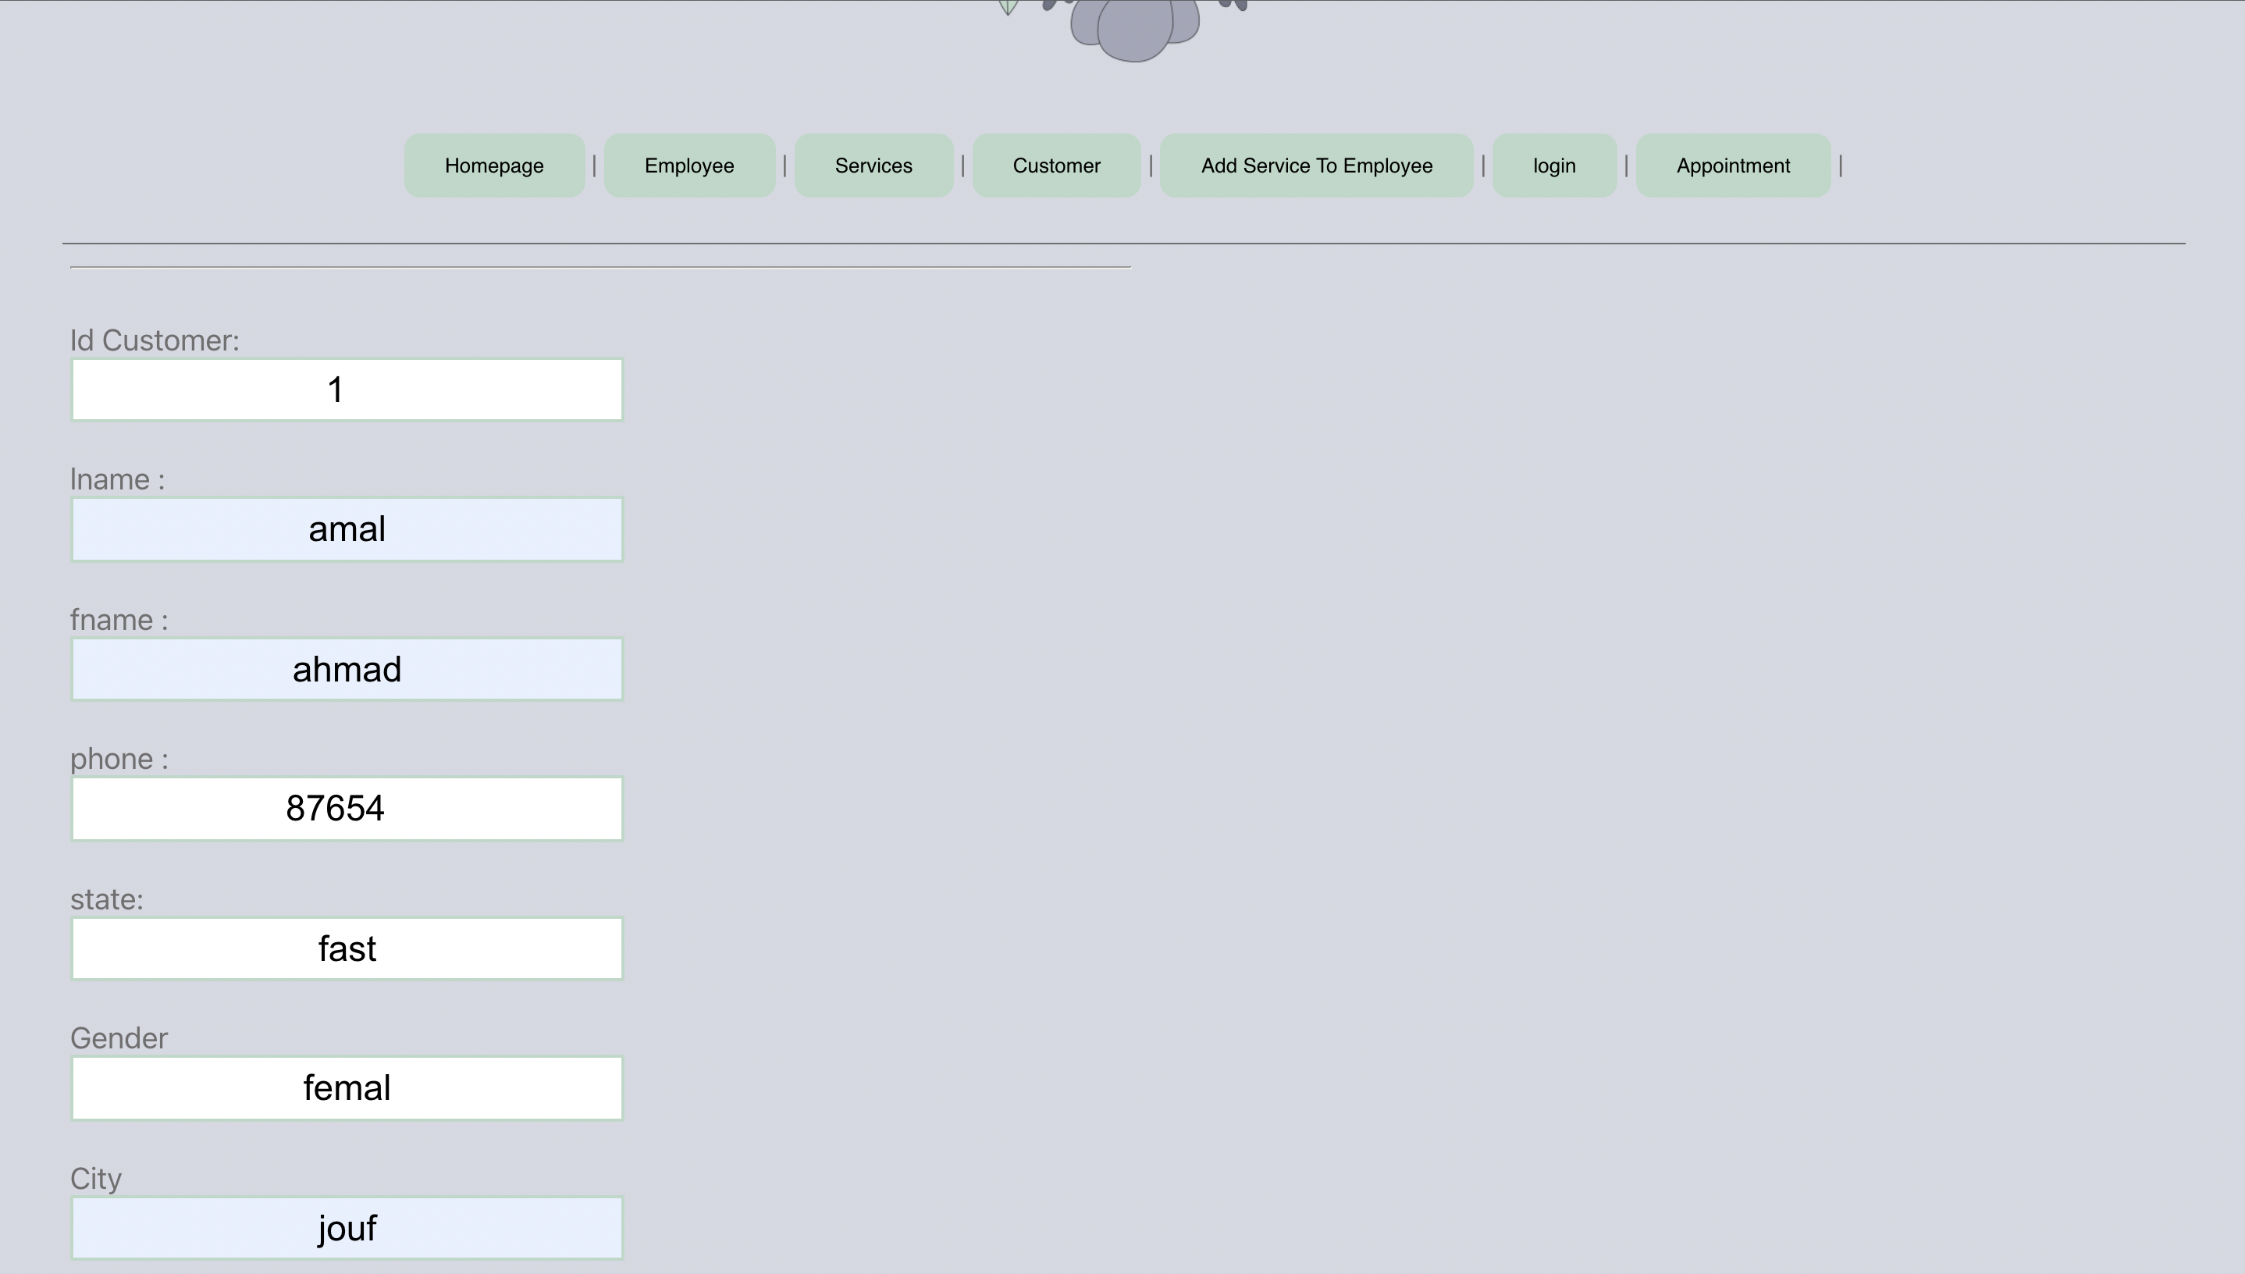
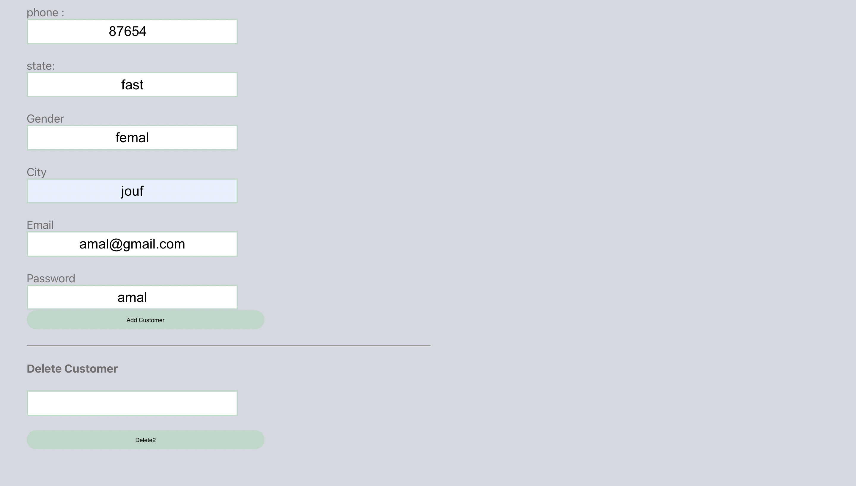

Slide 11
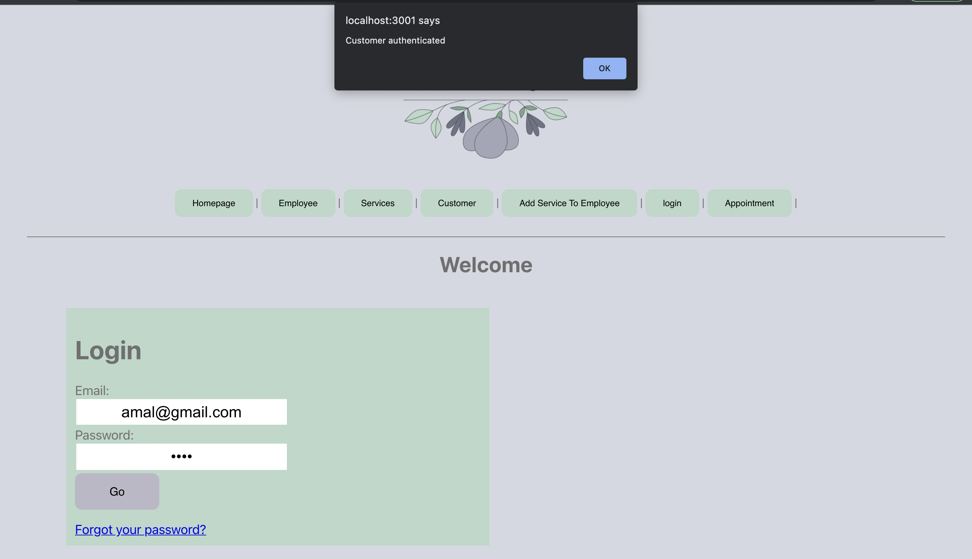

Slide 12
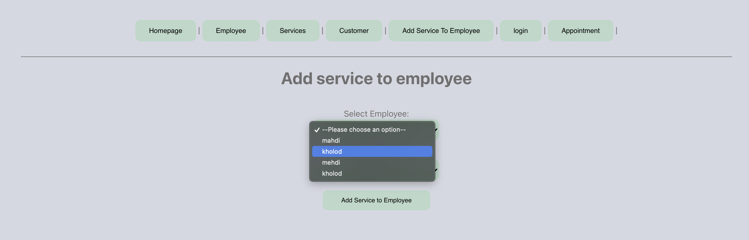
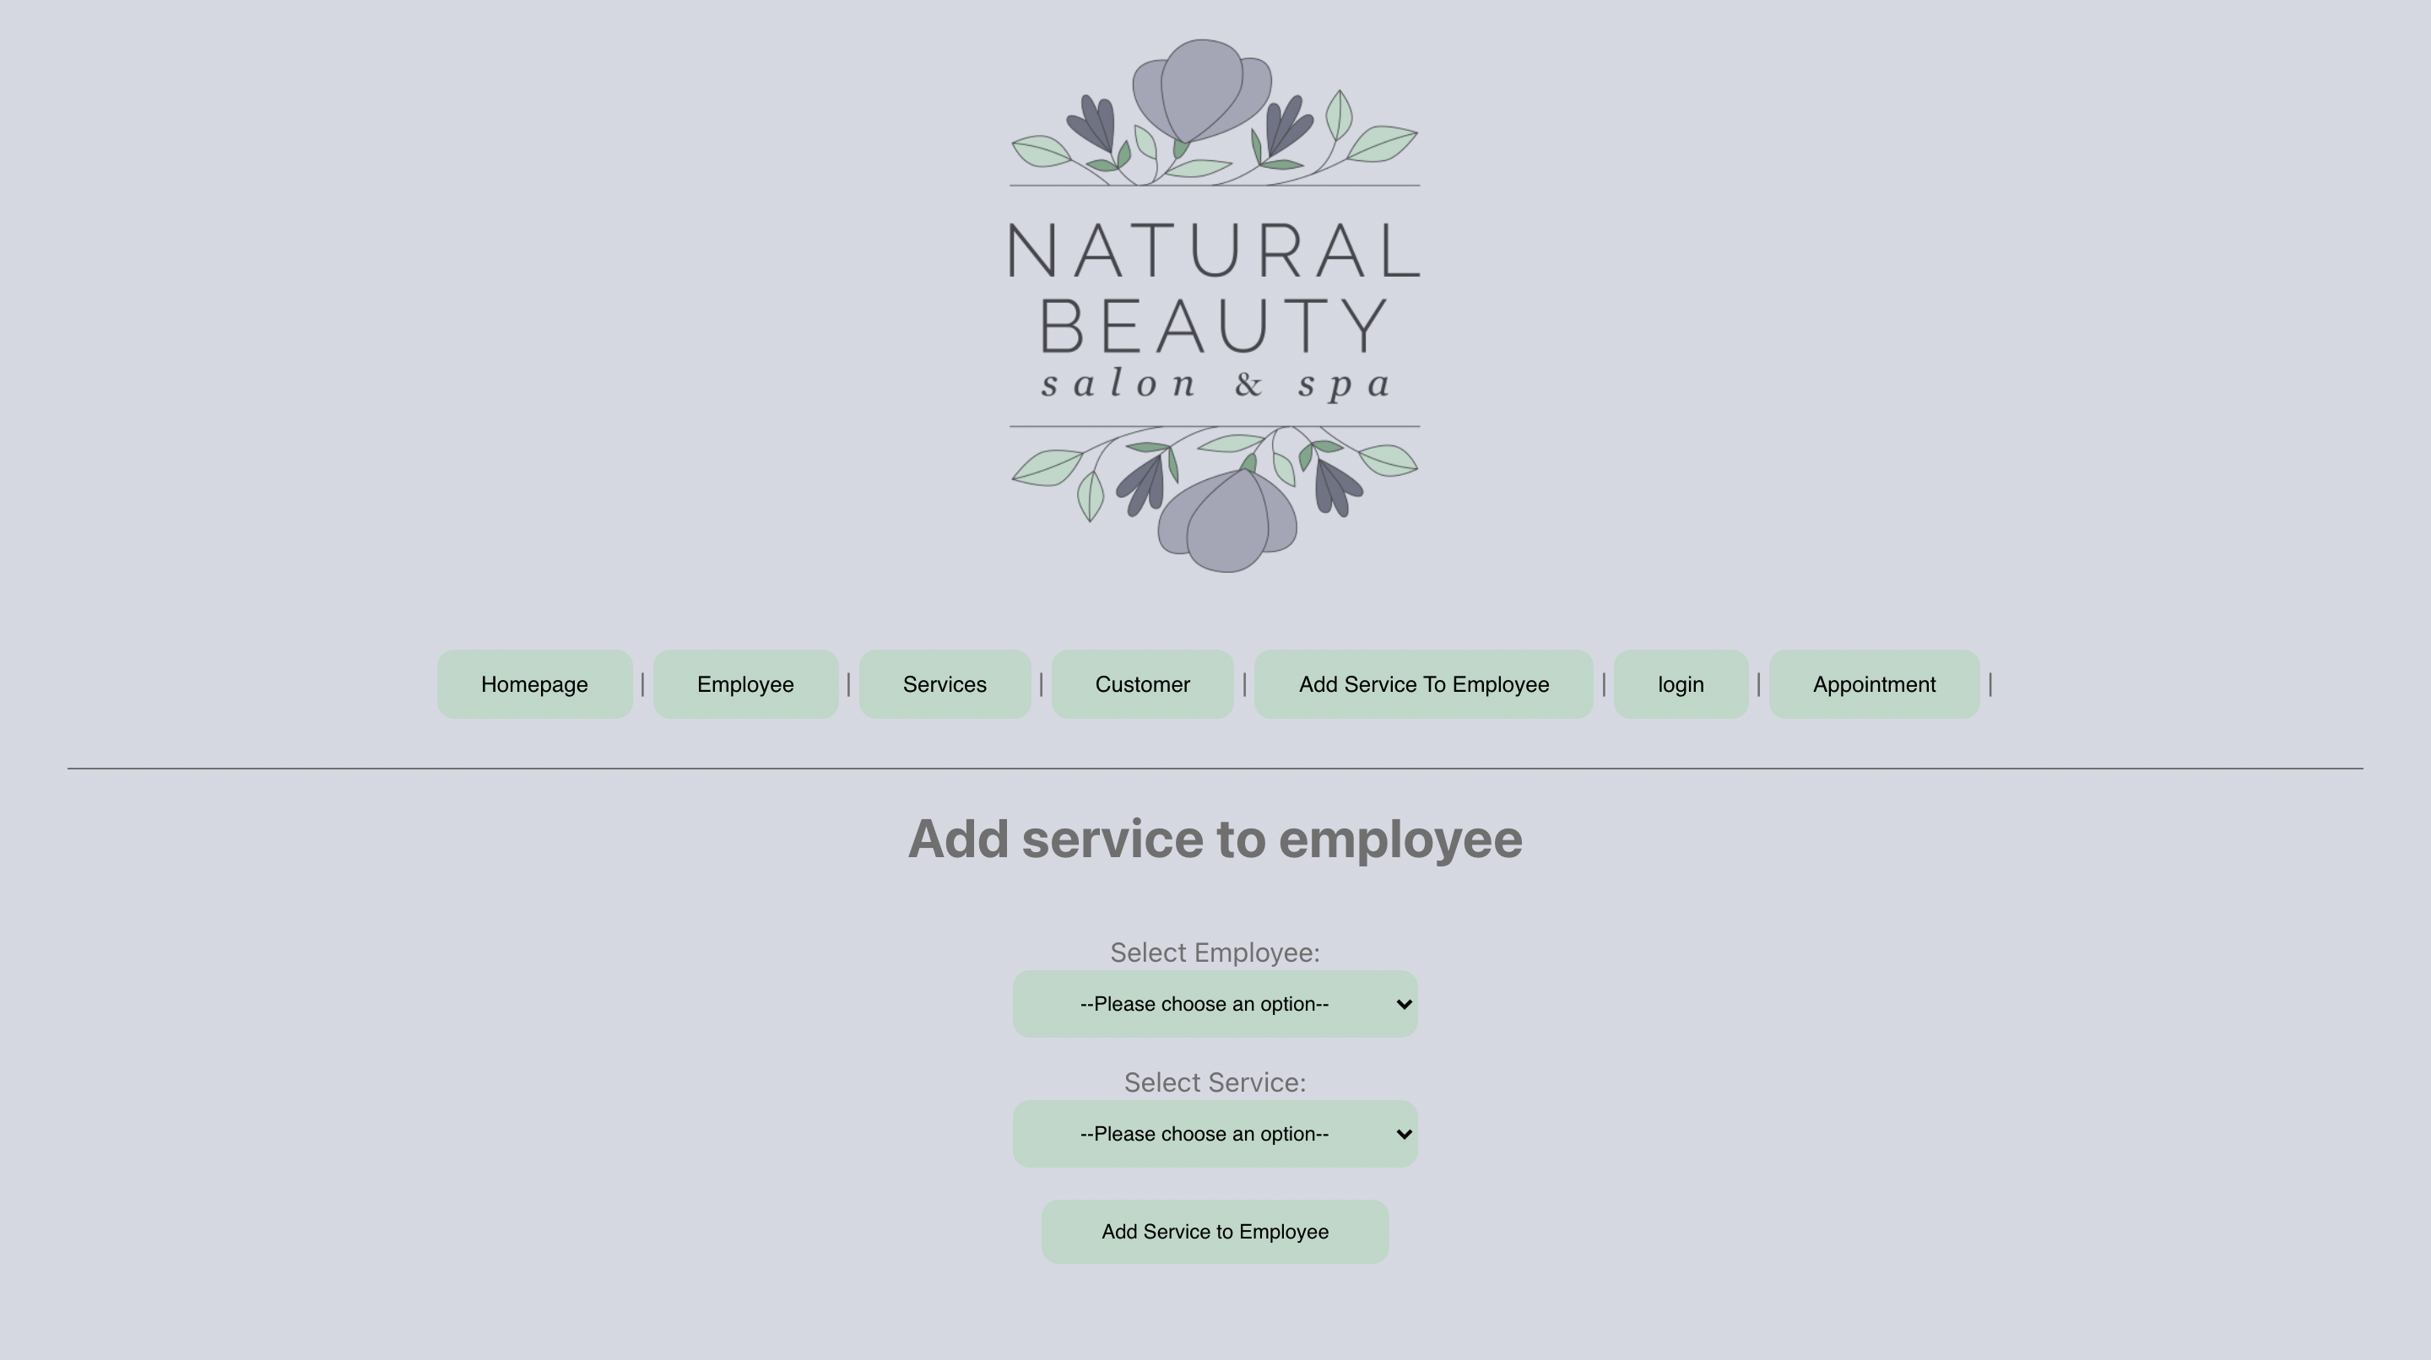

Slide 13
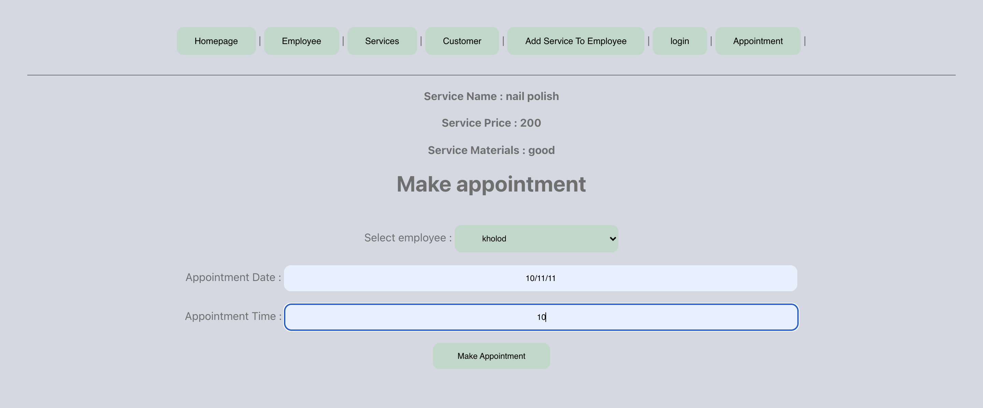

Slide 14
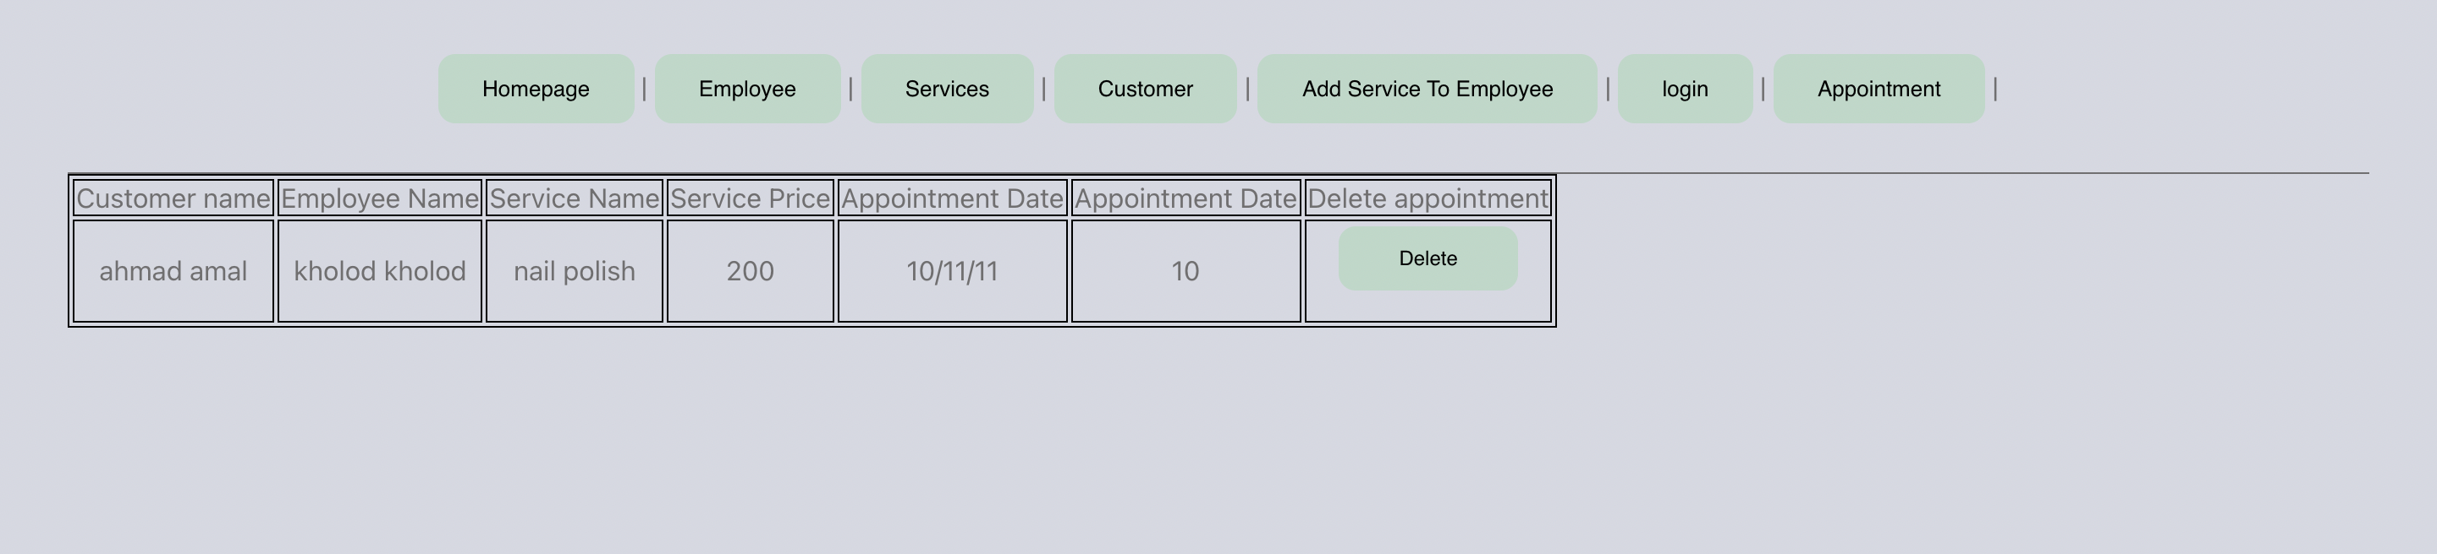

Slide 15
Technologies used
FRONT END DEVELOPMENT
BACK END DEVELOPMENT

Slide 16
FRONT END:
It is the visible part of website or web application which is responsible for user experience. The user directly interacts with the front end portion of the web application or website.
FRONT END Languages used:
CSS
React
JavaScript
html

Slide 17
BACK END :
It refers to the server-side development of web application or website with a primary focus on how the website works. It is responsible for managing the database through queries and
APIS by client-side.
backend Languages used:
MySQL
Java
Spring boot

Slide 18
The favorite part:
was working on react
using the react components , routings , local storage and hooks

Slide 19
The difficult part was linking the back end to the frontend

Slide 20
What are the new things you learned creating this application?
I learned a lot about MVC architecture in backend and react hooks and local storage in frontend

Slide 21
